Slide 1

Recurrent Neural Networks(RNNs) Jovan L. Thompson June 12, 2024

Slide 2
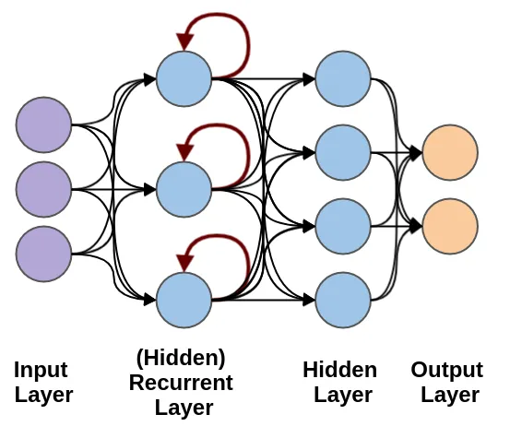
Table of Contents
Introduction to Recurrent Neural Networks (RNNs)
Core Concepts of RNNs
Architecture of RNN Sequences
Challenges with Training RNN Models
Conclusions
References

Slide 3

Introduction to Recurrent Neural Networks (RNNs)
What are RNNs?
RNNs are a specialized type of neural network designed for sequence data, capturing time dependencies and patterns.
Unlike traditional neural networks, RNNs have connections that form directed cycles, enabling them to maintain a 'memory' of previous inputs.
Why are RNNs Important?
RNNs excel in tasks where context and sequential information are crucial.
RNNs can handle variable-length sequences, making them versatile for various applications.
Their ability to model time dynamics makes them ideal for tasks requiring historical context.
How are RNNs Used?
Time series forecasting (stock prices, weather prediction).
Text generation (chatbots, creative writing).
Speech recognition (voice assistants, transcription).
Machine translation (language translation tools).

Slide 4
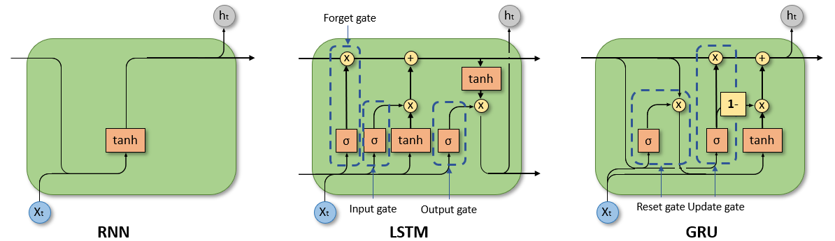
Core Concepts of RNNs
Types of Datasets
Time Series Data: Stock prices, weather data, sensor readings.
Text Data: Sentences, paragraphs, or entire documents.
Sequential Data: Music, speech signals, video frames.
Widely Used Libraries
TensorFlow: A comprehensive deep learning framework by Google.
Keras: A high-level API for building and training deep learning models, built on TensorFlow.
PyTorch: A flexible deep learning framework used for research and production by Facebook.
Popular Architectures
Simple RNN: Basic RNN architecture that suffers from vanishing gradient problems.
LSTM (Long Short-Term Memory): Designed to overcome the limitations of simple RNNs by capturing long-term dependencies.
GRU (Gated Recurrent Unit): A simplified version of LSTMs that is computationally more efficient.
Maity, S. (2024, March 20).
RNN, LSTM, and GRU:
Why Do We Need Them?

Slide 5
Architecture of RNN Sequences
Biological Behavior
RNNs process input data one element at a time, maintaining a hidden state that carries information from previous steps.
This "memory" allows RNNs to understand context and relationships within sequences.
RNN architecture is inspired by the recurrent connections in the human brain, where neurons continuously communicate with each other, forming complex patterns of activity over time, maintaining a form of short-term memory.
RNN Workflow
Input sequence is fed into the network.
Hidden states update at each timestep, maintaining memory of previous inputs.
Output is generated based on the current input and the hidden state.

Slide 6
Challenges with Training RNN Models
Vanishing and Exploding Gradients
Gradients can become too small (vanishing) or too large (exploding), making training difficult.
Example: Training deep RNNs on long sequences often leads to vanishing gradients, hindering learning.
Overfitting
RNNs can easily overfit to the training data due to their high capacity and complexity.
Example: In speech recognition, overfitting can lead to poor generalization on new audio samples.
Additional Challenges
Training RNNs can be computationally intensive and time-consuming.
RNNs require large amounts of labeled sequential data for effective training, which can be hard to obtain.

Slide 7
Conclusions
RNNs are specialized neural networks designed to process sequence data by maintaining a form of memory through directed cycles, making them highly effective for tasks that require contextual understanding and time dependencies. This unique capability is particularly useful in areas such as time series forecasting, text generation, speech recognition, and machine translation, where the order and context of the data are crucial.
Popular architectures within RNNs, such as LSTM and GRU, have been developed to address the vanishing gradient problem associated with traditional RNNs. These advanced architectures enable the capture of long-term dependencies and improve the performance of RNN models in practical applications.
However, training RNN models comes with significant challenges. The issues of vanishing and exploding gradients can hinder the learning process, especially when dealing with long sequences. Additionally, training RNNs is computationally intensive and requires substantial amounts of labeled data, which can be difficult to obtain. Overfitting is another concern due to the high capacity and complexity of RNN models, potentially leading to poor generalization on new data.
To mitigate these challenges, various techniques and architectures, such as LSTM and GRU, have been developed. These models incorporate mechanisms to regulate the flow of information, which enhances their ability to learn from sequential data without suffering from vanishing gradients. Libraries like TensorFlow, Keras, and PyTorch provide powerful tools and frameworks for building and training RNN models, which facilitates their application in real-world scenarios.
In conclusion, while RNNs offer significant advantages for sequential data processing, their successful deployment requires addressing inherent training challenges and leveraging advanced architectures and tools. By overcoming these hurdles, RNNs can deliver robust solutions for a wide range of applications, which ultimately enhances the capabilities of AI systems in handling temporal data.

Slide 8
References
Chaturvedi, N. (2021, June 8). Recurrent neural network with Keras: Project implementation and cheatsheet. DataDrivenInvestor. Retrieved from https://medium.datadriveninvestor.com/recurrent-neural-network-with-keras-b5b5f6fe5187
Pedamallu, H. (2020, November 14). RNN vs GRU vs LSTM. Analytics Vidhya. Retrieved from https://medium.com/analytics-vidhya/rnn-vs-gru-vs-lstm-863b0b7b1573
Maity, S. (2024, March 20). RNN, LSTM, and GRU: Why Do We Need Them? LinkedIn. Retrieved from https://www.linkedin.com/pulse/rnn-lstm-gru-why-do-we-need-them-suvankar-maity-joegc/
Indrajitbarat. (2023, August 13). Recurrent Neural Networks (RNNs): Challenges and Limitations. Medium. Retrieved from https://medium.com/@indrajitbarat9/recurrent-neural-networks-rnns-challenges-and-limitations-4534b25a394c
Tondak, A. (2023, June 23). Recurrent Neural Networks (RNN) Tutorial: RNN Training, Advantages & Disadvantages (Complete Guidance). K21 Academy. Retrieved from https://k21academy.com/datascience-blog/machine-learning/recurrent-neural-networks/

